Slide 1
Teachmate AI-Powered Learning Assistant for classrooms
Team Members:
Shreya (SW22ECE080)
Vaishnavi Shendre (SW22ECE106)
Vajreshwari (SW22ECE107)
Institute Name:
Department Of Electronics and Communication ENGINEERING
Faculty Of Engineering and Technology (Exclusively FOR Women),
Sharnbasva University,
Kalaburagi, Karnataka.
UNDER THE MENTORSHIP OF:
Prof. Laxmi Patil

Slide 2
1. INTRODUCTION
TeachMate is an AI-powered, voice-driven assistant that supports learning inside and outside classrooms. It converts spoken topics into a structured summary, multiple-choice quiz, and AI-generated image using GPT-3.5 and DALL·E. TeachMate is low-cost, scalable, and efficient-ideal for educational institutions with limited resources.
TeachMate demonstrates the seamless integration of speech recognition, text summarization, question generation, and visual synthesis in a single web interface using free libraries and open tools.
The system is designed to run efficiently on standard laptops without a graphics processing unit (GPU), making it accessible for widespread adoption in the education sector.

Slide 3
2. PROBLEM STATEMENT
Traditional education systems often lack adaptability and fail to meet the personalized needs of diverse learners.
Educators spend excessive time creating content, and students struggle with theoretical learning. Many schools lack digital infrastructure.
TeachMate solves this with an AI-based assistant that generates summaries, quizzes, and visuals from voice input in real time.

Slide 4
3. OBJECTIVES
Develop a voice-based AI assistant
Convert voice to text
Summarize complex content
Generate topic-based quizzes
Produce AI-generated visuals
Use Gradio for browser UI
Ensure compatibility with basic laptops
Save time and enhance engagement

Slide 5
4. TECHNOLOGIES USED
Python 3.8+ (core programming language)Gradio
UI/UX interaction in browserOpenAI GPT-3.5
Text summarization and quiz generationOpenAI DALL.E
Educational image generationSpeechRecognition (Google API)
For voice-to-text transcriptionPIL and requests
For processing and displaying imagesFree, CPU-based tools compatible with basic laptops

Slide 6
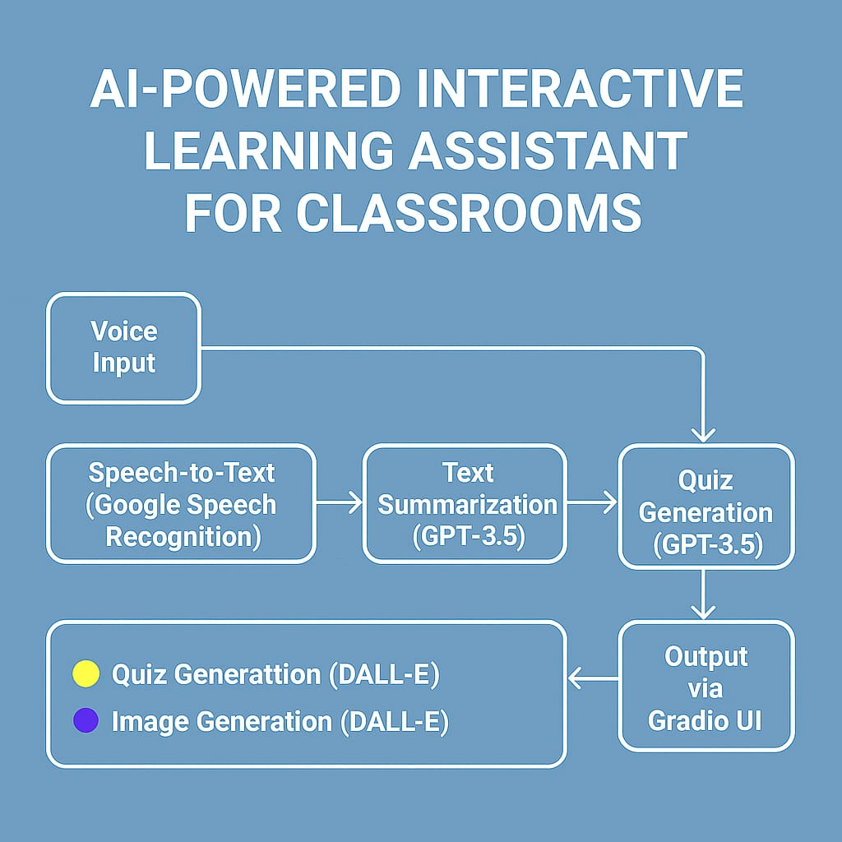
5. SYSTEM ARCHITECTURE
Voice Input: User records or uploads voice.
Speech Recognition: Converts audio into text using Google Speech API.
Summarization: Transcribed text is summarized using GPT-3.5.
Quiz Generation: MCQs are generated from the summary using GPT.
Image Generation: Summary is passed to DALL·E to produce a visual.
Output Interface: Gradio displays the final summary, quiz, and image.

Slide 7
6. USE CASE SCENARIOS
Use Case 1 – Classroom Teaching Aid:Teachers can speak a lesson topic aloud and instantly receive a structured summary, quiz, and image. This helps in preparing digital content faster and more interactively.
Use Case 2 – Student Self-Learning:Students can revise any topic by simply speaking it to the system. TeachMate will provide them with a summary and test questions on the spot.
Use Case 3 – Inclusion for Visually Impaired:TeachMate can be integrated with text-to-speech tools to read summaries and quizzes aloud, enabling accessibility for visually impaired learners.

Slide 8
7. ADVANTAGES & LIMITATIONS
Advantages
Limitations
Open-source and free
Runs on basic laptops
Enhances learning with visuals
Simple UI
Needs internet
Quiz/image accuracy depends on AI
No regional language support (yet)

Slide 9
8. RESULTS
Results observed during testing:
Transcription Accuracy: Above 95% for clear speech input.
Summarization Quality: Consistently produced 3–5 sentence summaries with appropriate structure.
Quiz Generation: Relevant and topic-aligned questions with 3–4 options each.
Image Generation: Visually relevant AI images based on the summarized topic.
The outputs displayed via the Gradio interface were clean and user-friendly, making the system highly usable for both teachers and students.

Slide 10
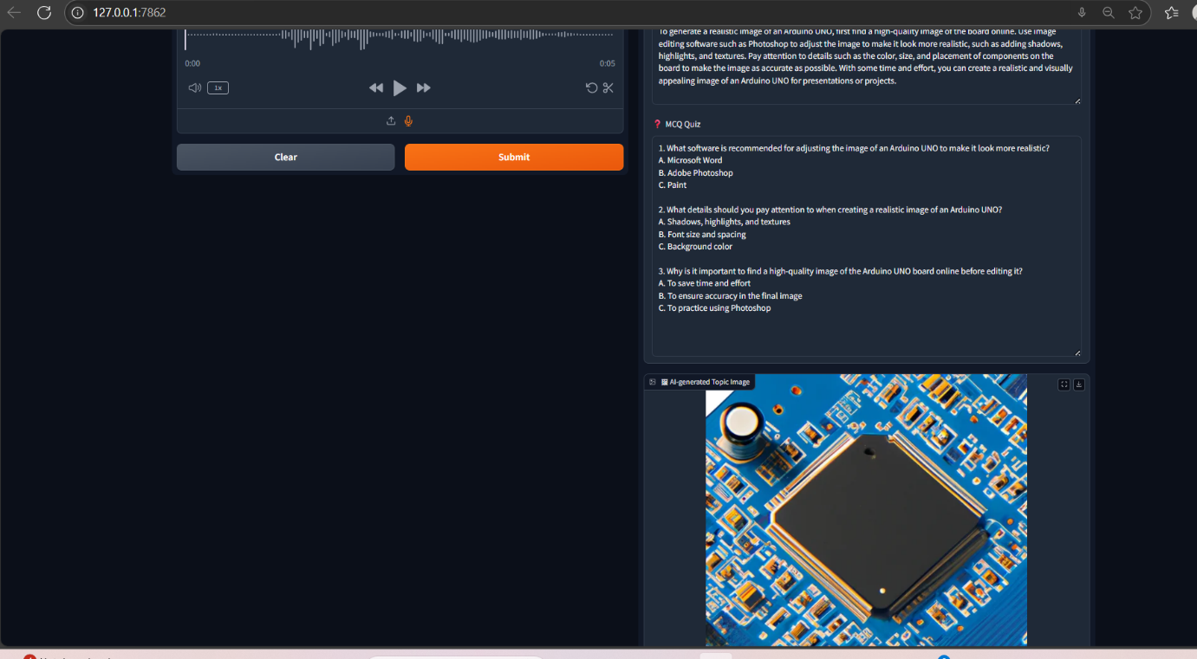

Slide 11
CONCLUSION
TeachMate presents a novel approach to improving classroom engagement by converting audio input into educational content using AI.
It uses freely available resources and is capable of running on standard hardware, making it ideal for use in schools and colleges with limited resources.
The system has real-world applicability and can serve as a foundation for developing more robust, multilingual, and intelligent learning tools.

